Slide 1
What is EAP-English for Academic Purposes?

Slide 2
EAP-English for Academic Purposes as the title implies
It is the study of English credit courses in order to better prepare the student for other academic credit courses taught in English.
The basic courses are:
Reading
Speech & Listening
Speech & Listening Lab
Grammar
Writing
Writing Lab

Slide 3
Recommendations
It is recommend that the students take these classes together as scheduled:
Reading
Speech/Listening
Speech/Listening Lab

Slide 4
continued
Grammar
Writing
Writing Lab

Slide 5
There are 6 levels of EAP and if you start in level 1 it will take you up to two years to complete the eap program (one level by semester: Fall, Spring, and summer)
Level 1
Level 4
Level 6
Level 2
Level 3
Level 5

Slide 6
The course id for level 1 follows:
EAP0120
EAP0100
EAP0100L
EAP0160
EAP0140
EAP0140L

Slide 7
The course id for level 2 follows:
EAP0220
EAP0200
EAP0200L
EAP0260
EAP0240
EAP0240L

Slide 8
The course id for level 3 follows:
EAP0320
EAP0300
EAP0300L
EAP0360
EAP0340
EAP0340L

Slide 9
The course id for level 4 with an option to combined level 4 with no lab follows:
EAP0420
EAP0400
EAP0400L
EAP0460
EAP0440
EAP0440L
NO LAB
EAP0486
EAP0485

Slide 10
The course id for levels 5 & 6 follows:
EAP1686
EAP1685
EAP1586
EAP1585
NO LAB
NO LAB

Slide 11
Testing requirements-NEW Students must take the accuplacer esl test
Testing - http://www.mdc.edu/main/testing/
Preparation prior to taking the test https://www.mdc.edu/main/testing/examprep/accuplacer_cpt.aspx
Please submit a Remote Testing Request Form by email Testing help west_testing@mdc.edu
For questions about testing you may call 305-237-8979

Slide 12
continued
Students who score 97 or above in the ACCUPLACER ESL reading/writing AND 4 or above on the essay (Write Placer ESL) test must take the ACCUPLACER NG (Next Generation) test passing score is 245+.
Students who complete level 4 must take the ACCUPLACER NG test mandated by the FLDOE-Florida Department of Education.
Most test scores are valid for two years unless you decide to retake the test after 24 hours of the first attempt with a valid pass to retake it.
You should take courses based on your current highest test results.
First time taking the test is free and the second time $10.00+.

Slide 13
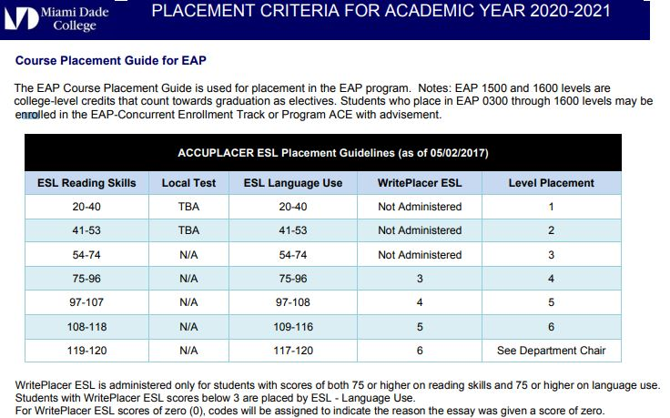
course Placement criteria table

