Slide 1
Miami Dade College West Departments and their functions-Most departments are open the following hours: Monday – Thursday: 8:00 AM to 7:00 PM Friday: 8:00 AM to 4:30 PM www.mdc.edu/west

Slide 2
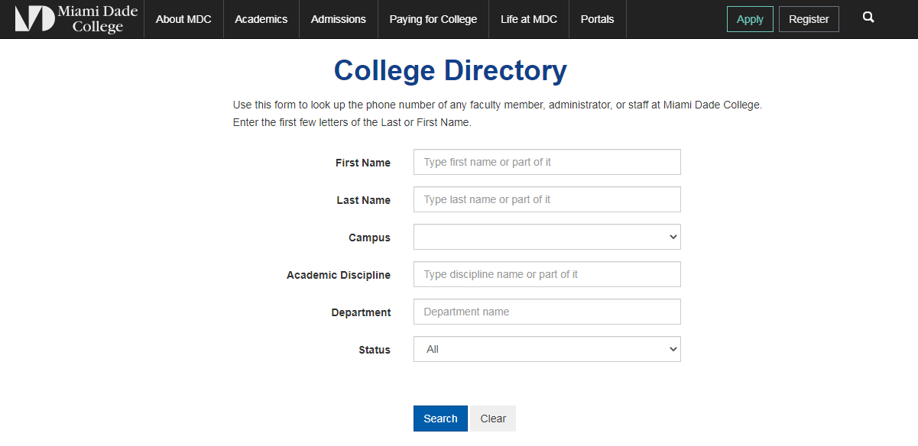
MDC College Directory https://mdcwap.mdc.edu/PhoneDirectory/default.aspx

Slide 3
New & International Student Center Room 2114 Call 305-237-9000 Room 2114 Call 305-237-8993
Helping new students including International Students with first hand information about the process of admissions and registration.
http://www.mdc.edu/internationalstudents
http://www.mdc.edu/internationalstudents/admission/default.aspx
https://www.mdc.edu/kendall/student_new.asp

Slide 4
Admissions and Registration Room 2108 Call 305-237-8900
http://www.mdc.edu/admissions/
WestAdmissions@mdc.edu
Readmissions after a year out of the college (not enrolled in classes).
You have to update your contact information online before readmission.
You may apply online, but you will have to bring proof of Florida Residency.
in person go to: http://www.mdc.edu/main/flresidency/
Tuition and fees depend on your Florida Residency status.
http://www.mdc.edu/about/tuition.aspx

Slide 5
Advisement-General Room 2114 Call 305-237-8947
http://www.mdc.edu/main/advisement/
westadvisement@mdc.edu
https://www.mdc.edu/about/contact/ live chat during working hours.
The advisement and career center helps students with their registration for regular classes once they have been admitted to the college.
Bring your individual questions and concerns to a general advisor.
If your are in need of English for Academic Purposes classes, you should go to the EAP Advisement to see an EAP Advisor in room 1218.

Slide 6
Financial Aid Room 2108 Call 305-237-8941
http://www.mdc.edu/financialaid/
https://mdc.financialaidtv.com/
westfinaid@mdc.edu
Transfer students.
Armed Services and Veterans.
Financial aid requirements and obligations.
Applying for aid.
Receiving aid.
Scholarships.
Workshops.

Slide 7
Testing Department Room 2110 Call 305-237-8979
west_testing@mdc.edu
http://www.mdc.edu/main/testing/about/west.aspx
To take the ACCUPLACER test.
CLEP.
GED.
PERT (valid for 2 years).
Credit-by-Exam.
Proctor Virtual College classes.
Visit, call or email us to learn more about the Testing Department.

Slide 8
Bursar’s Office Room 2115 Call 305-237-8951
https://www.mdc.edu/costs/
wbursars@mdc.edu
To pay for your classes.
To pay fees not covered by financial aid.
To receive reimbursement checks.
Claim missing checks.

Slide 9
Access Services Room 2121-11 Call 305-237-4958
http://www.mdc.edu/access/locations.aspx
Assistance That Makes a Difference
The College makes every reasonable effort to ensure equal access to educational opportunities and experiences for students with documented disabilities. These services can include:
Sign language interpreters.
Adaptive or assistive technology.
Note takers and more.
ACCESS representatives can help eligible students identify and arrange for accommodations that ensure success.
Academic Program Modifications and Exam Waivers
Under certain circumstances, ACCESS can arrange for program modifications, course substitutions, and waivers for placement and exit exams, in accordance with the College's Manual of Procedures.

Slide 10
Academic Affairs Room 1218 Call 305-237-8938
http://www.mdc.edu/asa/academic_affairs.asp
EAP Advisement westeapadvisor@mdc.edu
Business Advisement westbusinessadvisor@mdc.edu
STEM Advisement weststemadvisor@mdc.edu
Problems with overrides in registration.
Audit classes.
Add a course.
Change sections with instructor and/or department approval.
Change from audit status to credit status or from credit status to audit status
Student feedback.

Slide 11
EAP & Academic Support Lab Room 2120-2121 Lab Open M-R 8 am-9 pm Call 305-237-8986
https://www.mdc.edu/west/campus-information/directory.aspx
Lab for your EAP courses are located inside room 2121.
Writing Tutors.
Math Tutors.
Accounting Tutors.
Other resources are part of the EAP & Academic Support Lab.
BB (Blackboard) direct line 305-237-3800 to report issues of connectivity.
Request Support via phone, Bb, and via email.
The ASL is open Saturdays from 9 am-2 pm.

Slide 12
Student Life Room 1122-01 Call 305-237-8904
http://www.mdc.edu/west/student-life.aspx
Get involved in student organizations and extracurricular activities:
http://www.mdc.edu/west/sga.aspx
Leisure activities.
Get your MDC ID Card and parking decal.
The Reporter a student Newspaper http://www.mdcthereporter.com/
If you don’t have a student account and you would like to create one now go to: https://myact.mymdc.net/create_account/identification.asp
Or Contact the Help Desk at 305-237-2505

Slide 13
iCED-Institute for Civic Engagement and Democracy Call 305-237-8960
https://www.mdc.edu/main/iced/students/
Welcome to the Student home page! At the left you will find tabs to all the resources you will need for civic engagement at Miami Dade College, from service-learning to volunteer service and scholarship opportunities. Check out the calendar of events for current opportunities, and use the above link to find an agency and register your service.
EAP Ambassador Volunteer.
Inside Student Life.

Slide 14
Learning Resources-Library-Computer Courtyard M-R 8 am-9 pm Room 1124 Call 305-237-8508
https://libraryguides.mdc.edu/srch.php
Multiple Learning Resources.
Computer Courtyards for students and faculty.
Tutors.
Copy.
Scan.
YouTube channel.
MYMDC account support.
Opens Saturdays from 8 am -1 pm

Slide 15
Dean of Students Room 2109 Call 305-237-4917
Grade Appeals approvals.
Students approvals of justified registration’s refunds.
Provides support with student issues.

Slide 16
President’s Office Room 1104 Call 305-237-8902
Dr. Beverly Moore-Garcia, West Campus President
Dr. Beverly Moore-Garcia is passionate about education, committed to the empowerment of others, and believes in the power of intentional serendipity. She has served within higher education for over 25 years and continues to be energized by the belief that educational opportunity changes everything.

Slide 17
Community Education-School of Continuing Education & Professional Development Room 1229 Call 305-237-8513
http://www.mdc.edu/ce/
Offering non-credit courses.
Online courses.
Classes in Spanish.
Summer camp.
Certification preparation.
GED/ESOL.
Corporate Training.

Slide 18
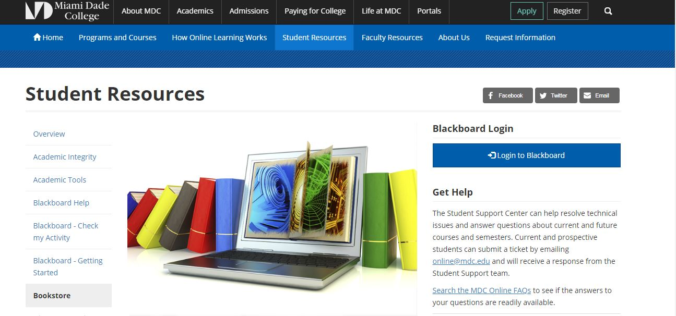
Bookstore Room 1122 Call 305-237-8953
https://www.mdc.edu/online/resources/bookstore.aspx

Slide 19
Network Services & Media Services Room 1108 Call 305-237-8929
The department is responsible for all Media and Network Service needs at West Campus.
Request for classroom equipment and delivery is completed on a first-come first-serve basis.
https://www.mdc.edu/west/campus-information/campus-services-mediaservices.aspx

Slide 20
Public Safety-Lost and Found Room 1101 Call 305-237-8100
Public Safety is in charge of Lost and Found on Campus.
Parking issues.
Following rules inside the college.
http://www.mdc.edu/west/campus-information/directions.aspx

