Slide 1
Miami Dade College, West Campus
EAP Speech Online Instructions for Using
Rosetta Stone: Tell Me More
Academic Support Lab
Room 2121
(305) 237-8986
EAP Lab
Room 2120
(305) 237-8948
Students may not exceed 5 lab hours per day, unless approval from the lab manager is obtained. You may visit our website at http://eapsupportlab.weebly.com for online information.
westeap@mdc.edu

Slide 2
Academic Support Lab
Building 2, Room 2121
Hours of Operation
Monday ― Thursday | 8:00 am – 9:00 pm
Friday | 8:00 am – 4:30 pm
Saturday | 9:00 am – 2:00 pm
Contacts
(305)237-8948
(305)237-8986
westeap@mdc.edu

Slide 3
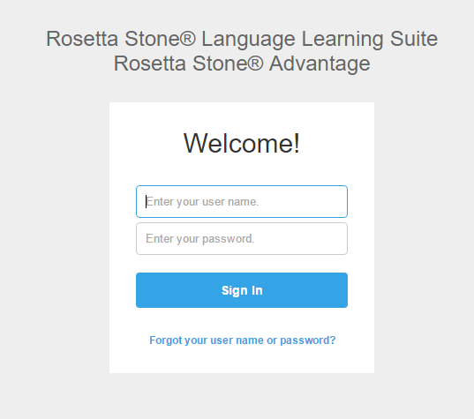
Instructions for Working in Your Speech Lab Course
ALL STUDENTS MUST BRING RECEIPTS TO THE LAB TO GET REGISTERED BEFORE STARTING ACTIVITIES AND HOURS
1. Purchase the access through the Campus Bookstore
2. Take Your Receipt to the front desk so that a Lab staff member may register your access
3. Obtain user name and password via email within 24 hours
4. Open a browser of choice (Internet Explorer, Google Chrome, or Mozilla Firefox).
Type in the navigation bar the following url address: admin.tellmemorecampus.com
Enter your new Tell Me More username and password.
If you forget your username or password, please review the email or see the lab staff for assistance.

Slide 4
When Registering into Tell Me More
Tell Me More is now Rosetta Stone
To use Tell Me More, students must purchase the TMM License at the Bookstore and bring the receipt to the front desk of the Academic Support Lab to be processed by the lab staff.
Once a student submit their license receipt, the student will receive an email from their MDC student email with a new username, password and the website link to Tell Me More within 24 hours.

Slide 5
What’s in Rosetta Stone?
Students are REQUIRED to take an Assessment Test in order to access their activities and the Progress Test after completing the activities.
Each topic has a fair amount of activities for the entire semester.
Example: Level 5 will appear as illustrated above.
(The rest of the levels will be the same except with different subjects.)

Slide 6
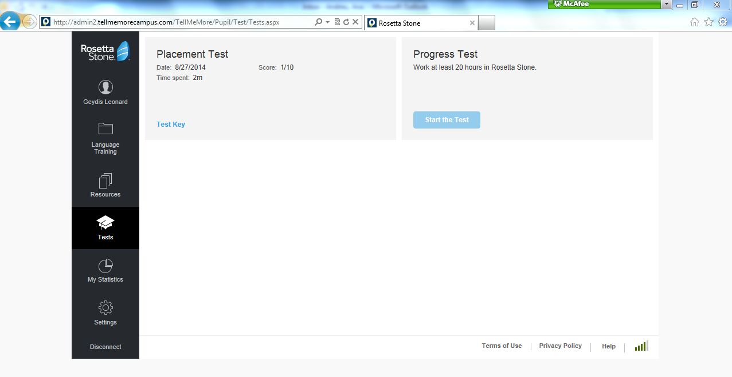
After finishing the activities, students are required to take the Progress Test:
The Progress Test is accessible after accumulating 15 hours in the web-based program
Students are not graded by the score of the Progress Test. The student receives credit for taking the test.
The Post Test will appear here on the student profile and in the Tests section after completing all activities and accumulating 15 hours in the program. The Post Test is worth 15 points of your final grade.

Slide 7
General Information
Students are required to complete 15 lab hours for their Speech Lab Course as follows:
Students may attend the lab any time during lab operating hours.
When students enter the lab, students must present their MDC ID card and see the staff to login into the computerized lab attendance system (Accudemia). When a student leaves the lab, the student must see the staff to log out. Student’s attendance is part of the grade!!
The program (Tell Me More) will generate a grade for all the activities attempted. It is strongly recommended that students plan their time accordingly! Students are responsible.
for completing all assigned activities, quizzes and post-tests with a maximum score of 100.
If a student drops their co-requisite EAP course, the student will automatically be dropped from the lab.
Students are RESPONSIBLE for immediately notifying EAP Lab Staff if there are any changes in their Lab level, Lab section, and / or surname; otherwise a failing grade will be assigned.
Students are RESPONSIBLE for immediately notifying EAP Lab Staff if they drop their corresponding co-requisite.

Slide 8
Be sure to complete all activities, any work that is not complete will be counted incomplete. THERE ARE NO MAKE-UPS.
Students must check their MDC email to receive information regarding to the EAP Lab.
Students must complete all activities by the deadline.
*Warning: Do not wait at the last minute to complete activities*
Students must bring their Time Log to the lab to record their hours.
EAP Lab Staff will not handle time disputes if students have not been taking accurate notes on their Time Log. Furthermore, an EAP Lab Staff member on duty will sign off on the Time Log to avoid any discrepancies.
Food, open beverage containers, and water bottles are PROHIBITED in the Lab!
The lab staff and Tutors will assist you in any way they can.
ASK QUESTIONS!

Slide 9
Grading Criteria: Total Possible Score
Completion of all of 15 hours in the Lab . . . . . . . . . . . . . . . . . . . . . 15 %
The 15 hours will be divided into 3 periods. The first 5 hours must be completed before the deadline. If a student does not meet any of the deadlines below , partial credit is deducted.
Completion of all activities with *good scores* . . . . . . . . . . . . . . . . 70%
Completion of the Post Test . . . . . . . . . . . . . . . . . . . . . . . . . . . . . . . . 15%
(maximum score possible 100)
1st: 5 Hours | 2nd: 5 Hours | 3rd: 5 Hours

