Slide 1
End of Spring Term
Luncheon

Slide 2
You are cordially invited to
The Academic
Support Lab Potluck
Luncheon
Where:
Room 2128
When:
Wednesday April 26, 2017
Time:
12:00
PM – 2:00 PM
Please RSVP your dish to Jennifer D by April 20th, and
please join us as we celebrate another successful semester.
Bring a covered dish to feed 4. Call 305-237-8986 or email
Jderonvi@mdc.edu

Slide 3
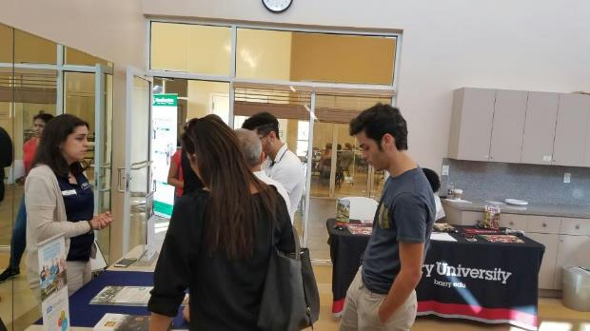
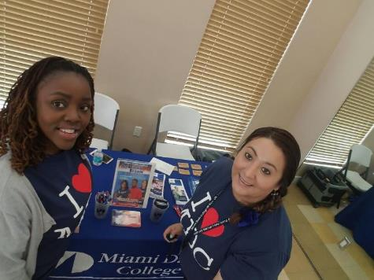
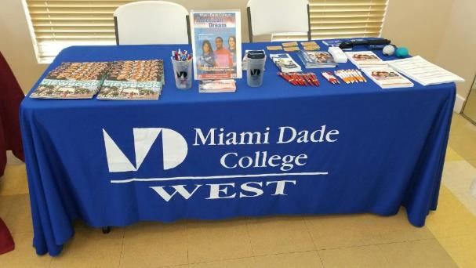
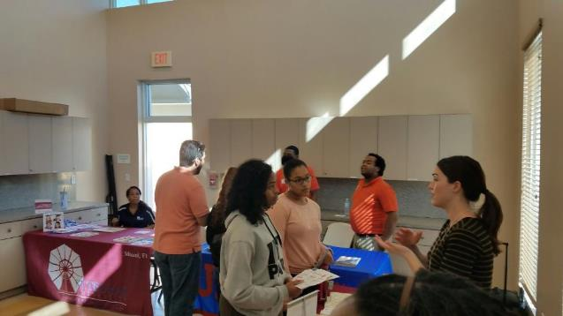
College Fair @ MDC West

Slide 4
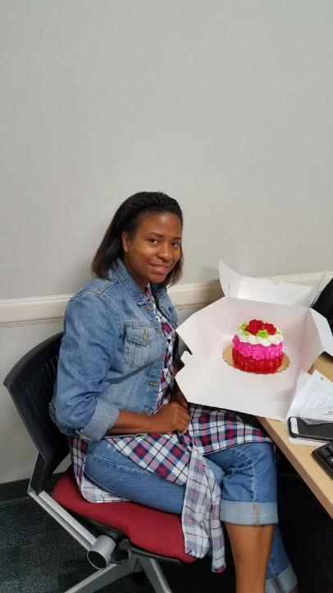
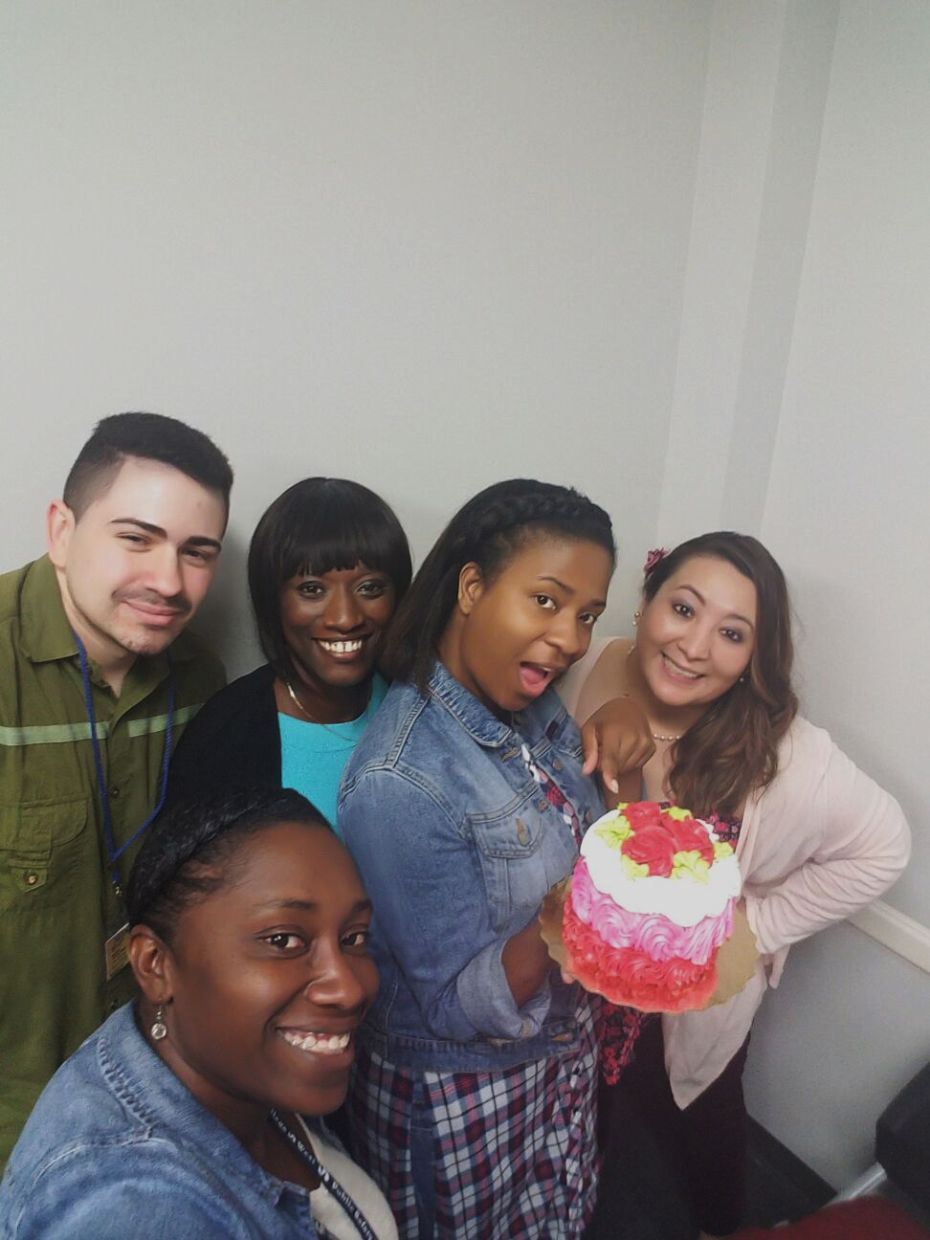
Happy
Birthday
Syretta!

Slide 6
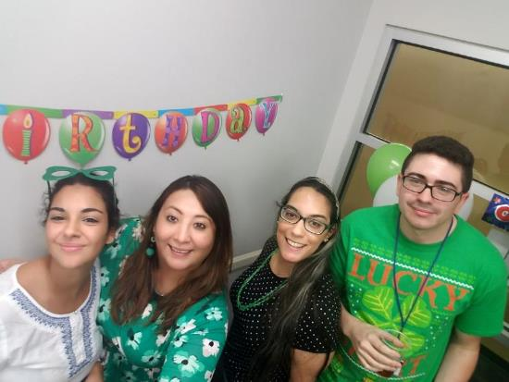
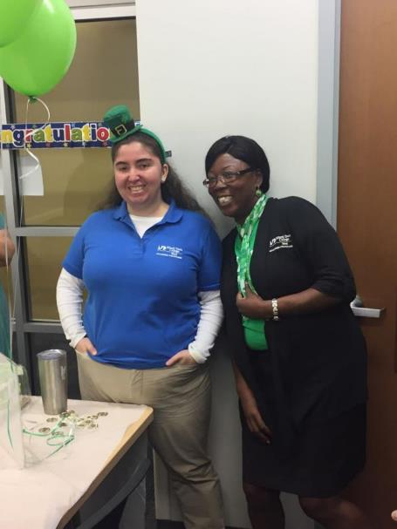
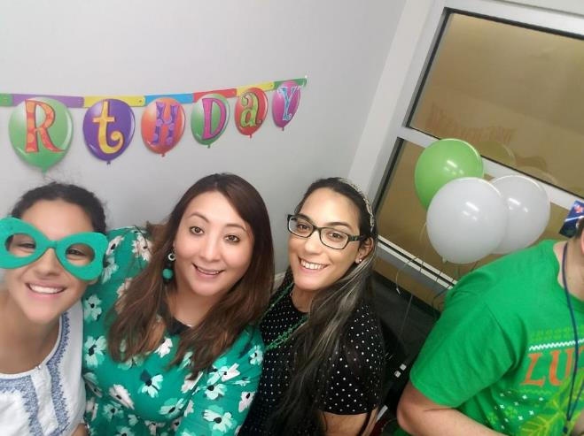

Slide 7
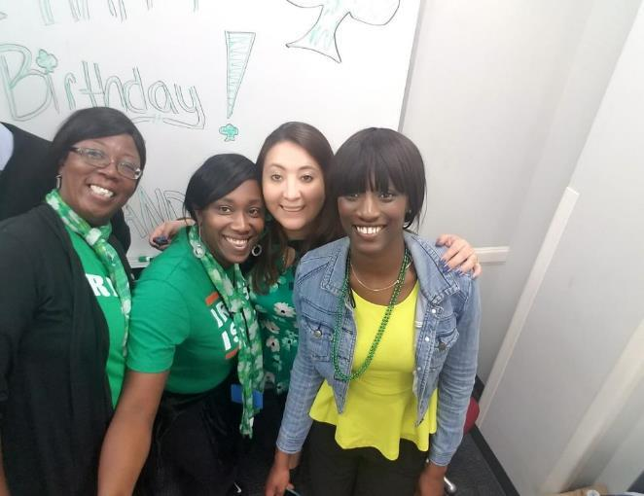
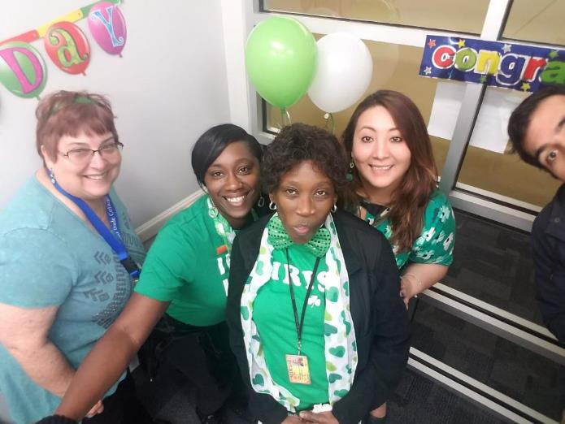

Slide 8
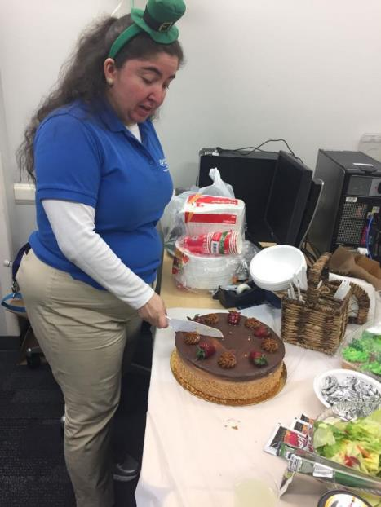
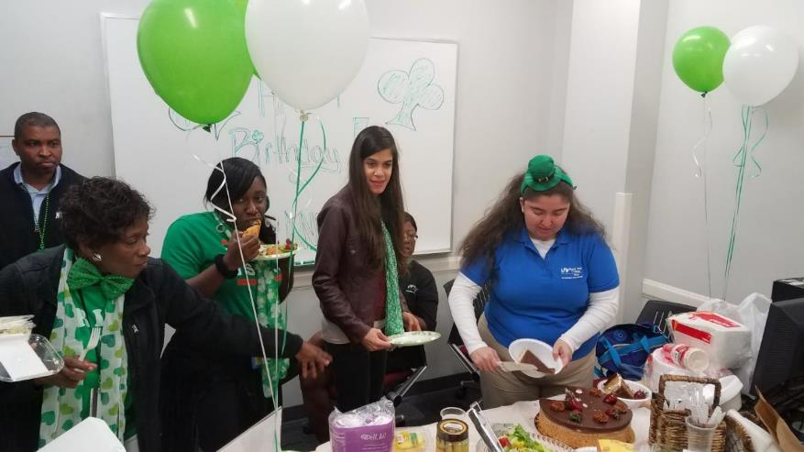

Slide 10
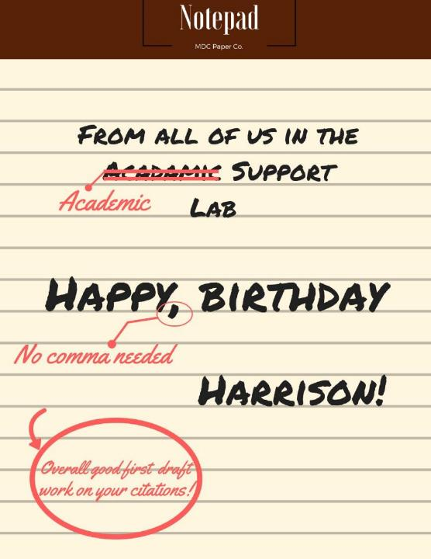

Slide 11
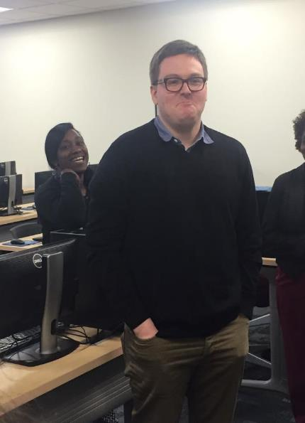
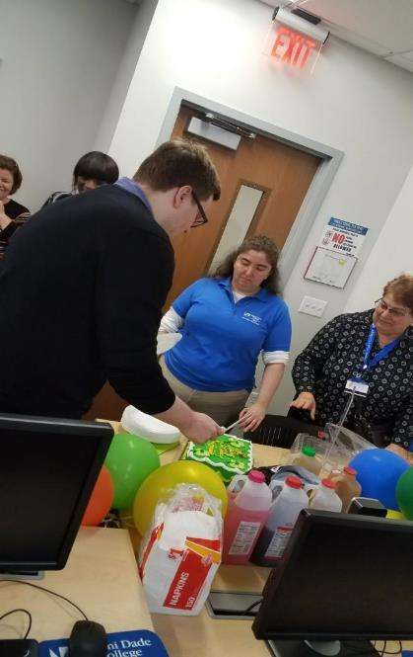
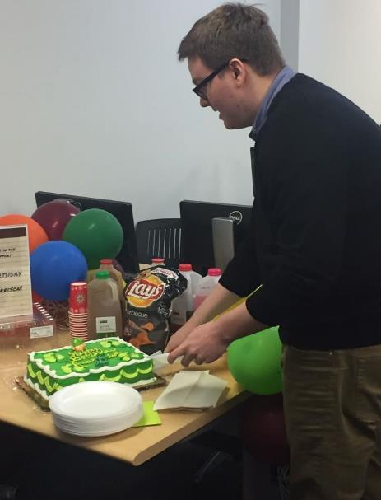

Slide 12
Tutors @ Work!

Slide 13
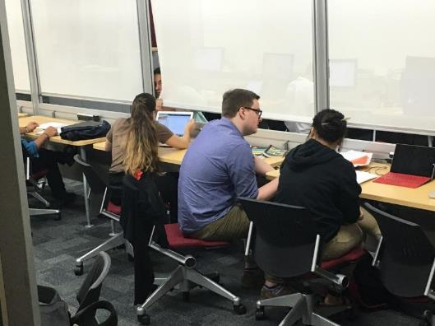
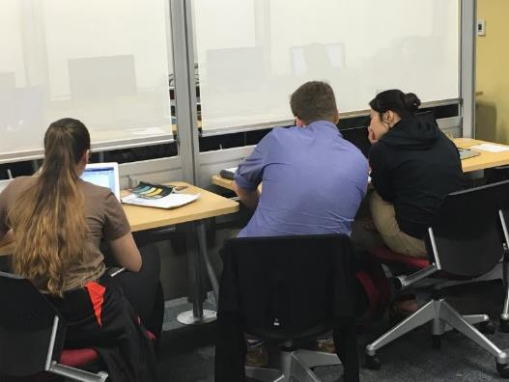
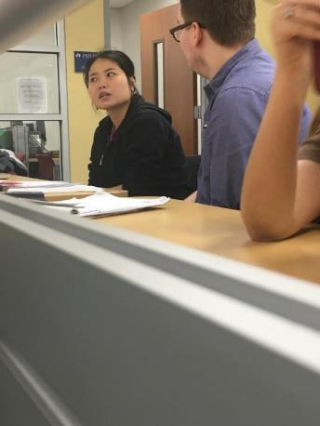
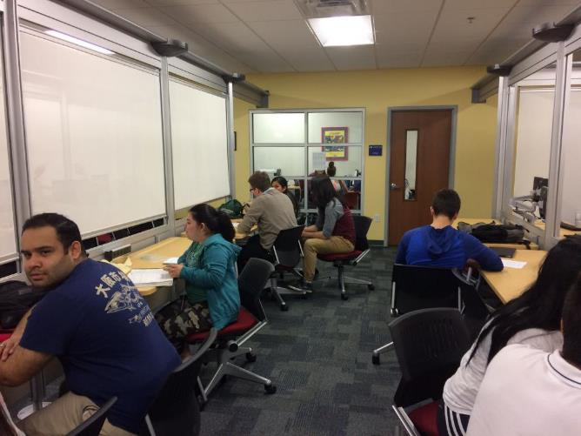
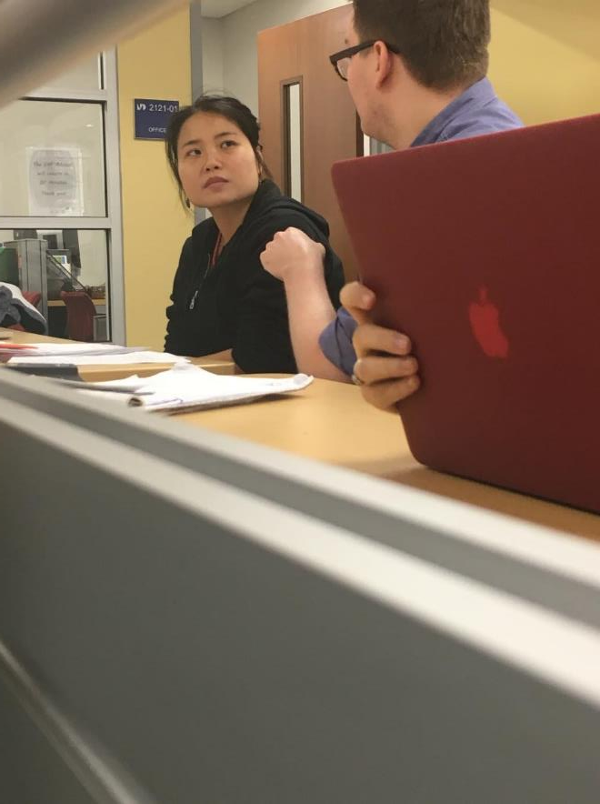

Slide 14
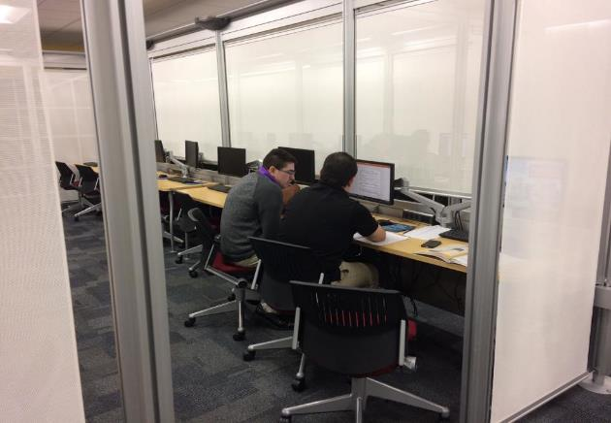
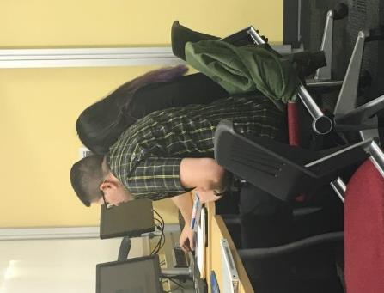
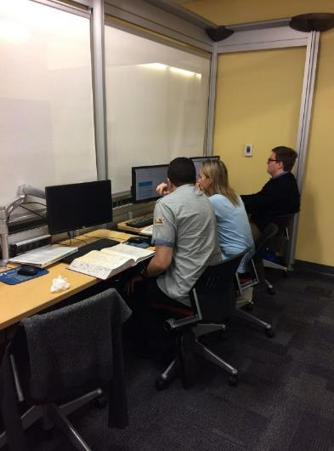
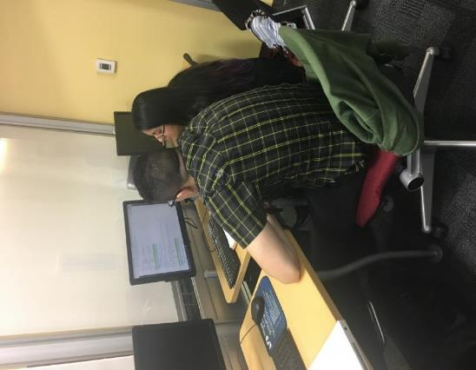

Slide 15
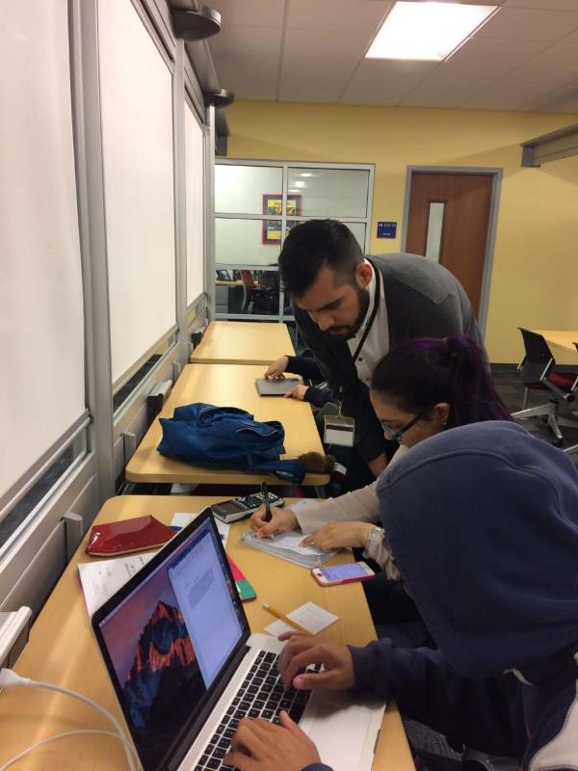
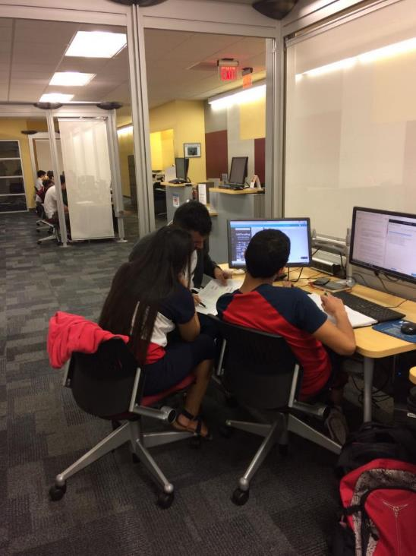

Slide 16
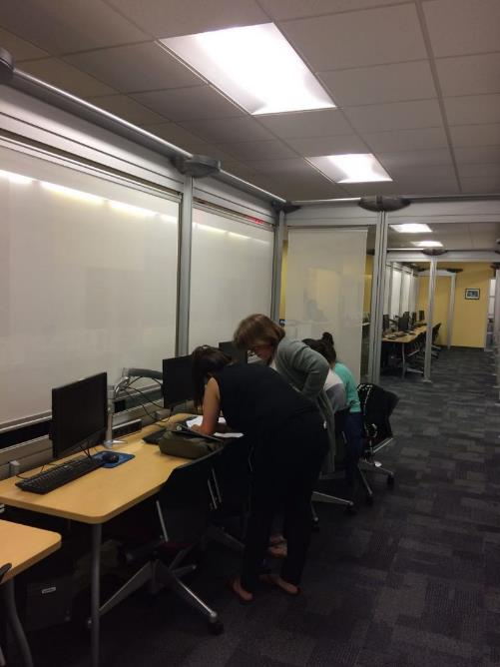
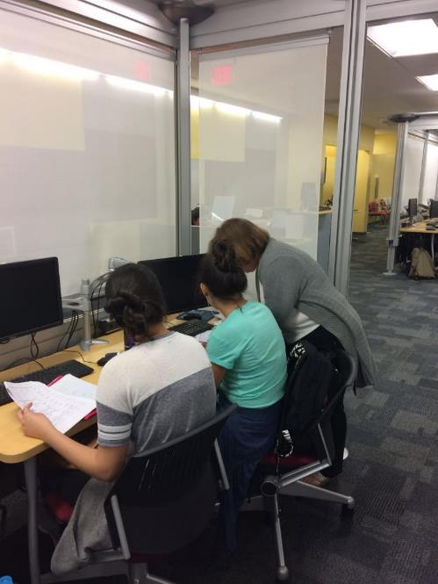
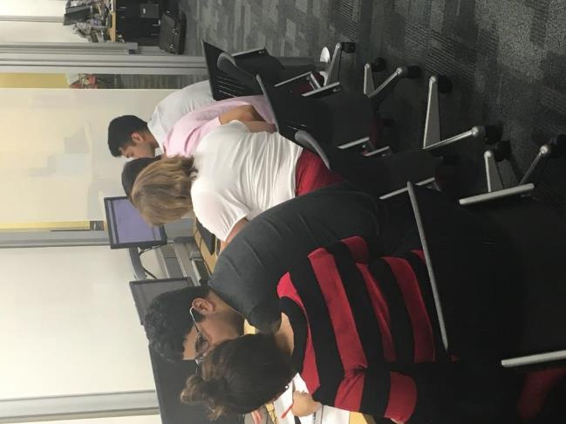

Slide 17
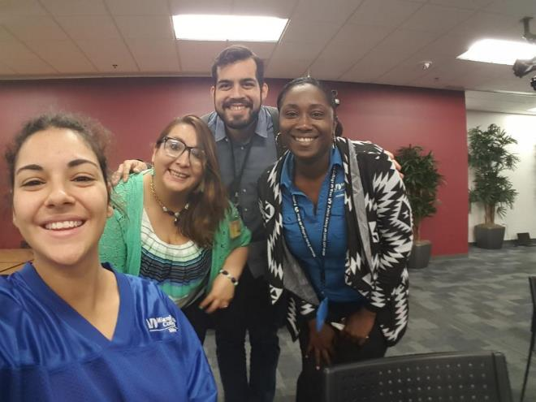
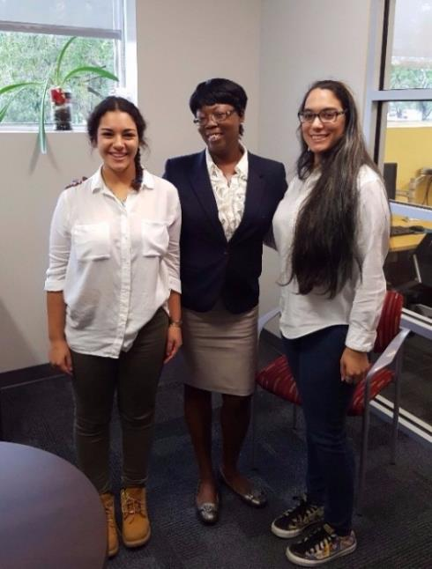
Our Fantastic
Peer Tutors

Slide 18
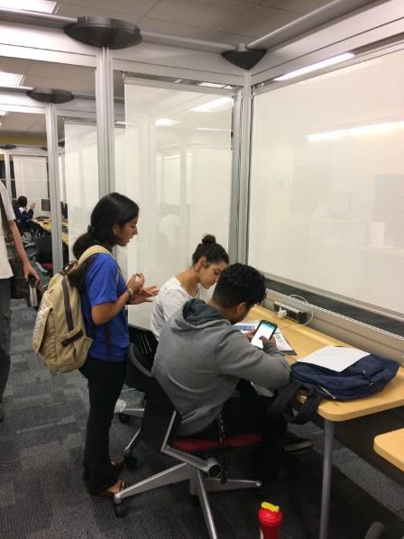
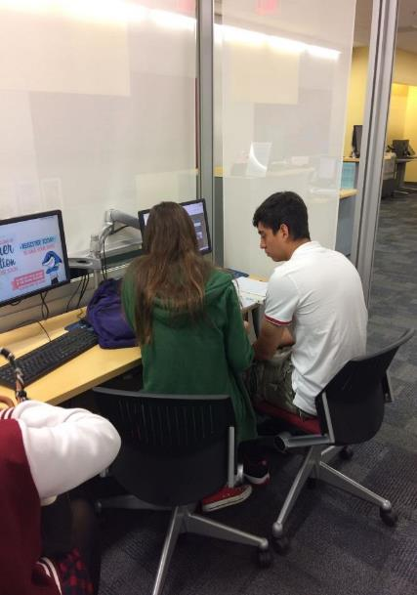
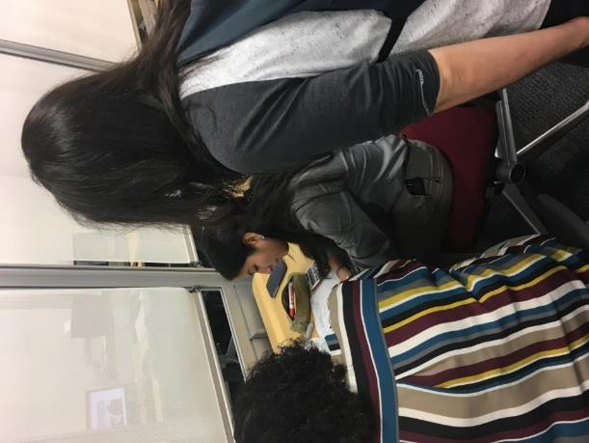

Slide 19
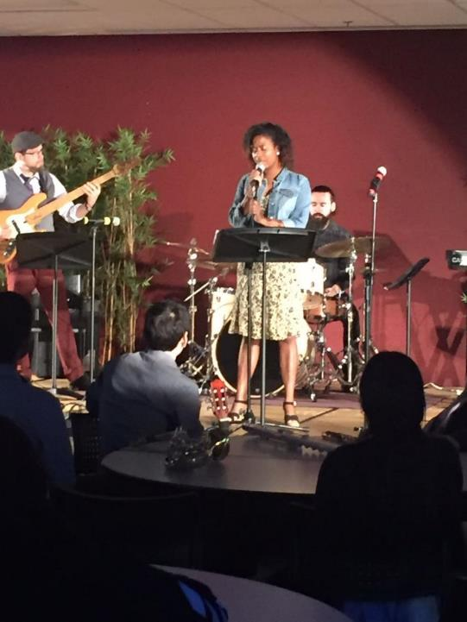

Slide 20
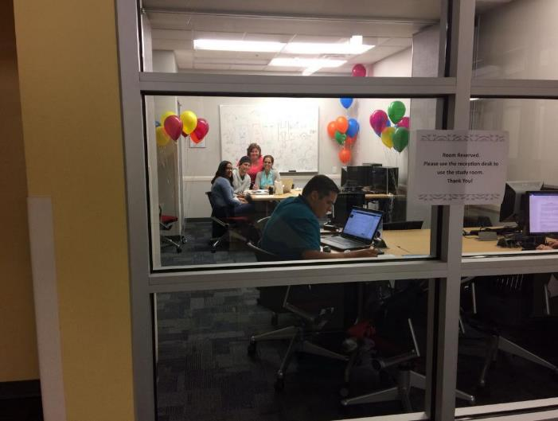
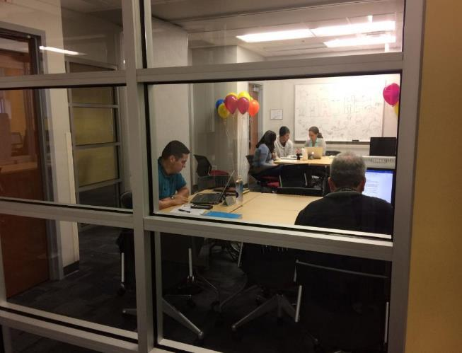
MATH MANIA!

Slide 21
School Tours of ASL

Slide 22
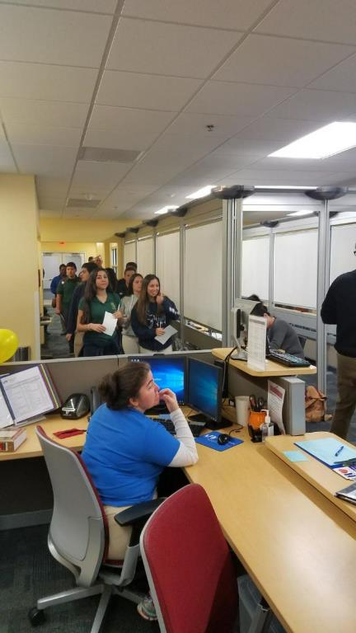
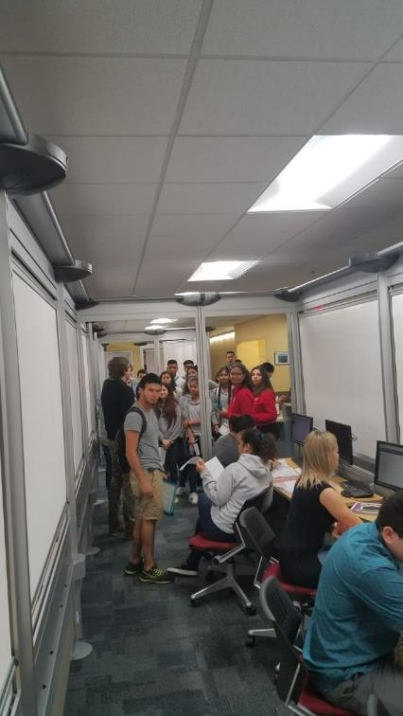
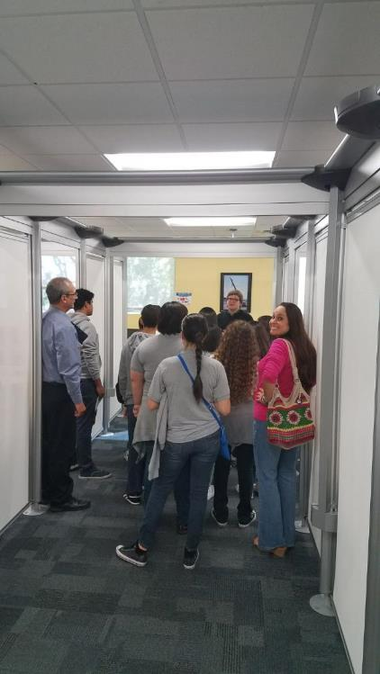

Slide 23
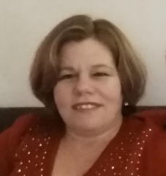
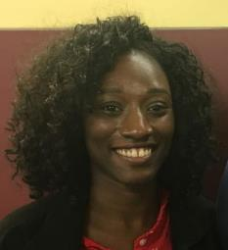
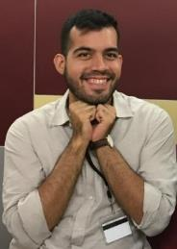
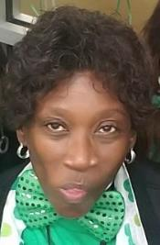
Graduations!
Rocio Garcia Miniet
Master's Degree in Math Education from Nova Southeastern University
Jennifer Deronville
Bachelors of Science from West Coast University.
William Marchant
Masters in Mechanical
Engineering from Florida International University
Cheryl Mudlrow Associate's in Business Administration from Miami Dade College

Slide 24
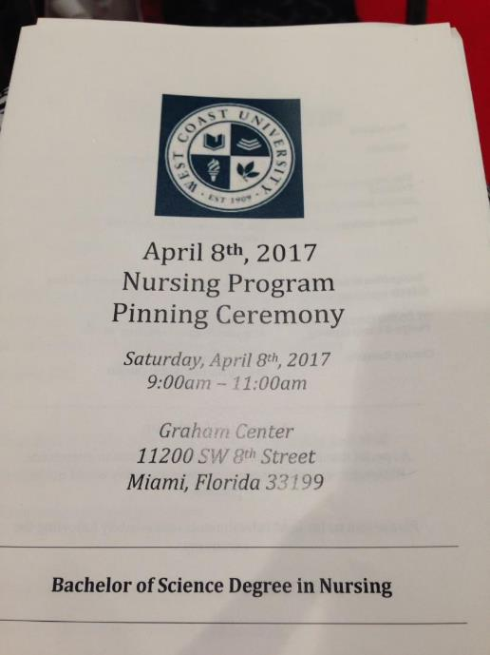
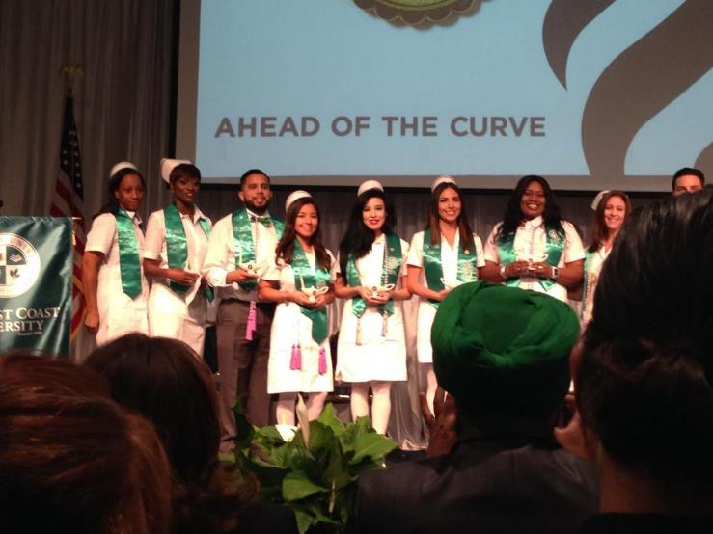
Congratulations
Jennifer!

Slide 25
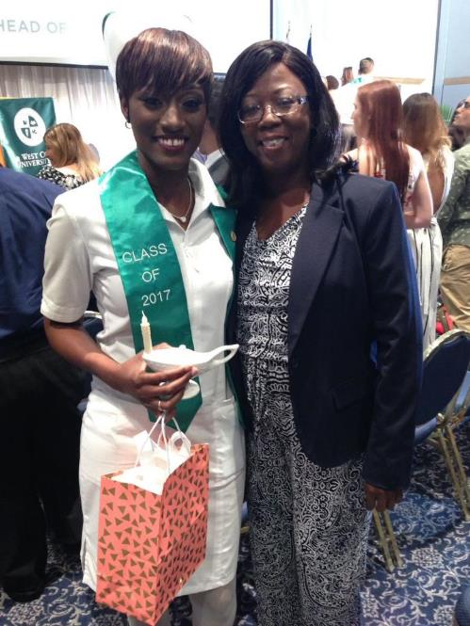
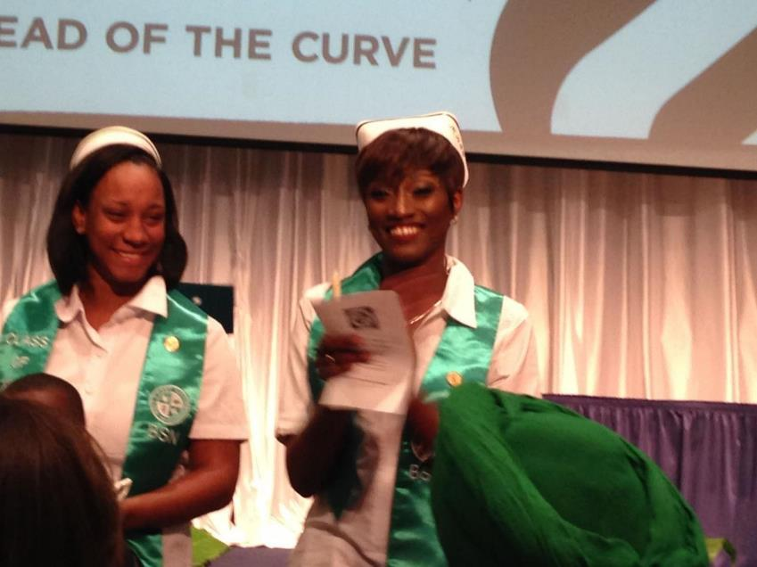

Slide 26
Learning In the ASL

Slide 28
On April 19, 2017, during the Student Life Awards Ceremony in room 1102 at the West Campus, we had the pleasure to recognize our dedicated volunteers, and the EAP & ASL department received the 2016-2017 Service Learning Project of the Year Award for the participation and the collaboration with iCED in the EAP Peer Ambassador, Math Peer Tutor, and English Peer Tutor Service Learning program.
EAP Peer Ambassador | Math Peer Tutor | English Peer Tutor
Yamira Flores (20) | Enrique Enriquez (35) | Briana De Tomas (20)
Marco Lopez (45) | Federico Jover (20) | Josefina Freitag (210)
 | Peter Lionoudakis (200) | Maria Khabbaz (20)
 | Amy Ramos (75) | Grecia Rodriguez (115)
 | Maria Rodriguez (60) | Nicolas Calvo (32)
 | Antonio Verde (10)
 | Sebastian Garcia (70)

