Slide 1
Miami Dade College, West Campus
EAP Writing Online Instructions for Using
Pearson MyEnglishLab
Academic Support Lab
Room 2121
(305) 237-8986
EAP Lab
Room 2120
(305) 237-8948
Students may not exceed 5 lab hours per day, unless approval from the lab manager is obtained. You may visit our website at http://eapsupportlab.weebly.com for online information.
Pearson Help Desk Go to: http://pearsonsupport.helpserve.com/pmc_clone
westeap@mdc.edu

Slide 2
Academic Support Lab
Building 2, Room 2121
Hours of Operation
Monday ― Thursday | 8:00 am – 9:00 pm
Friday | 8:00 am – 4:30 pm
Saturday | 9:00 am – 2:00 pm
Contacts
(305)237-8948
(305)237-8986
westeap@mdc.edu

Slide 3
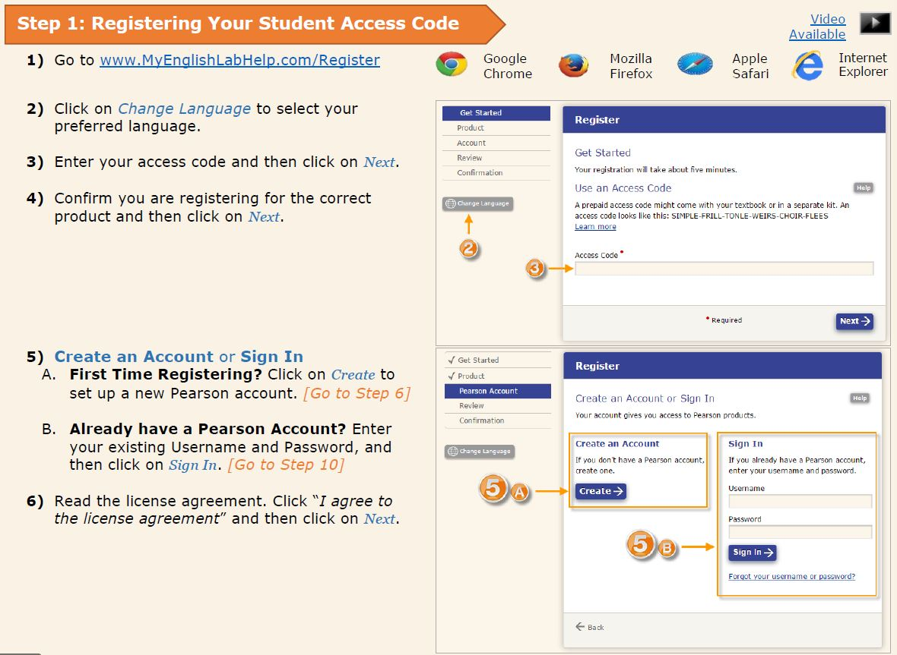
Step #1: Registering Your Access Code into MyEnglishLab

Slide 4
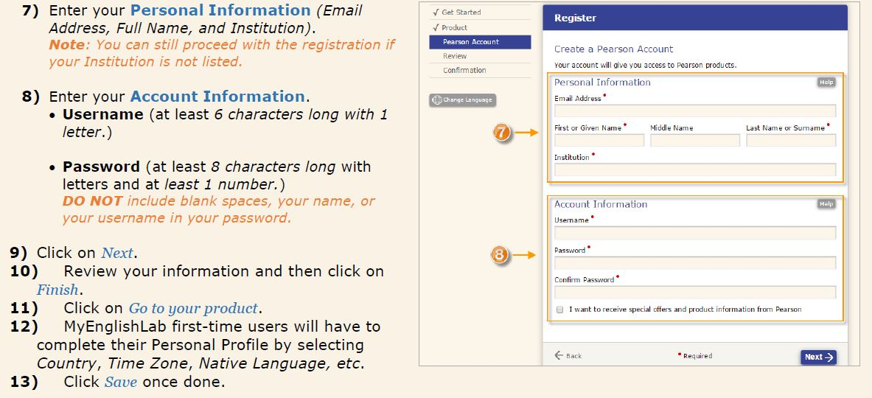
Step #1…..Enter Your Personal Information

Slide 5
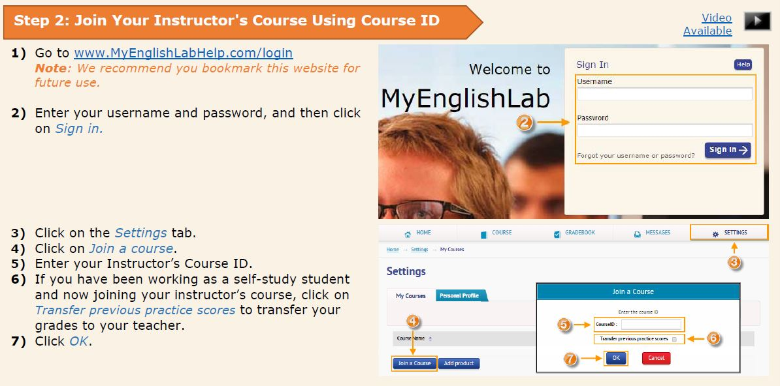
Step #2: Join Your Instructors Course or Lab

Slide 6
Step #3: Complete Assignments

Slide 7
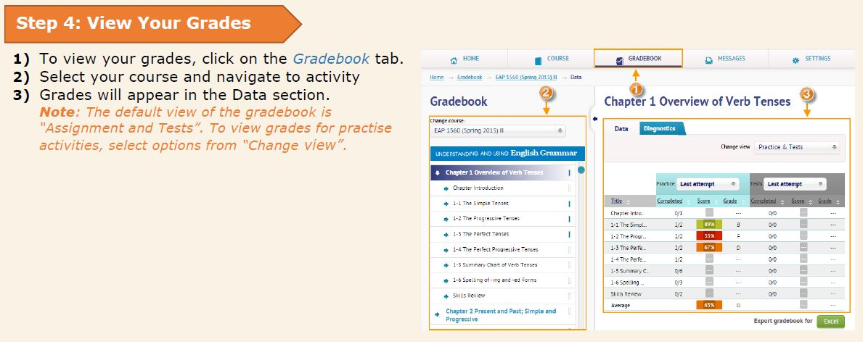
Step #4: View Your Grades

Slide 8
General Information
Students are required to complete 10 lab hours for their Writing Lab Course as follows:
Students may attend the lab any time during lab operating hours.
When students enter the lab, students must present their MDC ID card and see the staff to login into the computerized lab attendance system (Accudemia). When a student leaves the lab, the student must see the staff to log out. Student’s attendance is part of the grade!!
The program (Pearson MyEnglishLab) will generate a grade for all the activities attempted. It is strongly recommended that students plan their time accordingly! Students are responsible for completing all assigned activities, quizzes and post-tests with a maximum score of 100.
If a student drops their co-requisite EAP course, the student will automatically be dropped from the lab.
Students are RESPONSIBLE for immediately notifying EAP Lab Staff if there are any changes in their Lab level, Lab section, and / or surname; otherwise a failing grade will be assigned.
Students are RESPONSIBLE for notifying EAP Lab Staff if they drop their corresponding co-requisite.

Slide 9
Be sure to complete all activities, any work that is not complete will be counted incomplete. THERE ARE NO MAKE-UPS.
Students must check their MDC email to receive information regarding to the EAP Lab.
Students must complete all activities by the deadline. *Warning: Do not wait at the last minute to complete activities*
Students must bring their Time Log to the lab to record their hours.
EAP Lab Staff will not handle time disputes if students have not been taking accurate notes on their Time Log. Furthermore, an EAP Lab Staff member on duty will sign off on the Time Log to avoid any discrepancies.
Food, open beverage containers, and water bottles are PROHIBITED in the Lab!
The lab staff and Tutors will assist you in any way they can.
ASK QUESTIONS!

Slide 10
Grading Criteria: Total Possible Score
Completion of 10 hours in the Lab . . . . . . . . . . . . . . . . . . . . ……. . . . . 15 %
The 10 hours will be divided into 2 periods. The first 5 hours must be completed before the deadline. If a student does not meet any of the deadlines below , partial credit is deducted.
Completion of all activities including diagnostic test . . . . . . . . . . . . . . . 85%
(maximum score possible 100)
1st: 5 Hours | 2nd: 5 Hours
Monday, June 19, 2017 | Wednesday, July 19, 2017

