Slide 1
Meet your EAP Professors
Through LinkedIn and/or Coursicle

Slide 2
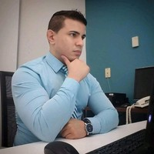
Professor Yoelvis Rodriguez https://www.linkedin.com/in/yoelvis-rodriguez-800390a0/
https://www.coursicle.com/mdcwest/professors/Yoelvis+Rodriguez/

Slide 3
Professor Carlos Gonzalez https://www.linkedin.com/in/carlos-gonzalez-6a18367/
https://www.coursicle.com/mdcwest/professors/Carlos+Gonzalez/
Professor Gonzalez online class survey

Slide 4
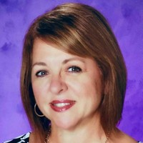
Professor Esther Hoffman https://www.linkedin.com/in/esther-hoffman-32b2885b/
https://www.coursicle.com/mdcwest/professors/Esther+Hoffman/

Slide 5
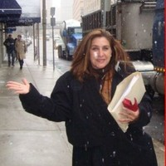
Professor Isabel Rodriguez-Dehmer https://www.linkedin.com/in/isabel-rodriguez-dehmer-ph-d-41030718/
https://www.coursicle.com/mdcwest/professors/Isabel+Rodriguez-Dehmer/

Slide 6
Professor Javier Vidal
https://www.coursicle.com/mdcwest/professors/Javier+Vidal/

Slide 7
Professor Shelly Sweeney
https://www.coursicle.com/mdcwest/professors/Shelly+Sweeney/

Slide 8
Professor Pedro Santos
https://www.coursicle.com/mdcwest/professors/Pedro+Santos/

Slide 9
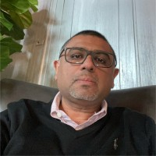
Professor Carlos Quintana https://www.linkedin.com/in/cqesol/
https://www.coursicle.com/mdcwest/professors/Carlos+Quintana/

Slide 10
Professor Carmen Munoz
https://www.coursicle.com/mdcwest/professors/Carmen+Munoz-Schira/

Slide 11
Professor Edgar Martinez https://www.linkedin.com/in/edgar-martinez-58815168/
https://www.coursicle.com/mdcwest/professors/Edgar+Martinez/

Slide 12
Professor Rebeca Fernandez
https://www.coursicle.com/mdcwest/professors/Rebeca+Fernandez/

Slide 13
Professor Emmie Blanco
https://www.coursicle.com/mdcwest/professors/Emmie+Blanco/

Slide 14
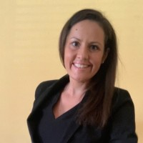
Professor Stephanie Best https://www.linkedin.com/in/stephanie-best-09ba3b69/
https://www.coursicle.com/mdcwest/professors/Stephanie+Best/

Slide 15
Professor Maria Colella
https://www.coursicle.com/mdcwest/professors/Maria+Colella/

Slide 16
Professor Elsa Gonzalez
https://www.coursicle.com/mdcwest/professors/Elsa+Gonzalez/

Slide 17
Professor Merlin Jones-Rose
https://www.coursicle.com/mdcwest/professors/Merlin+Jones-Rose/

Slide 18
Professor Svitlana Fowler
https://www.coursicle.com/mdcwest/professors/Svitlana+Fowler/

Slide 19
Professor Bisbetty Rodriguez-Roig
https://www.coursicle.com/mdcwest/professors/Bisbetty+Rodriguez-Roig/

Slide 20
Professor Telica Henry-Mcqueen
https://www.coursicle.com/mdcwest/professors/Telica+Henry-Mcqueen/

Slide 21
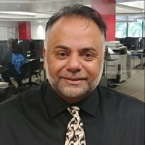
Professor Sanjeev Agrawal https://www.linkedin.com/in/sanjeev-agrawal-b526505/
https://www.coursicle.com/mdcwest/professors/Sanjeev+Agrawal/

Slide 22
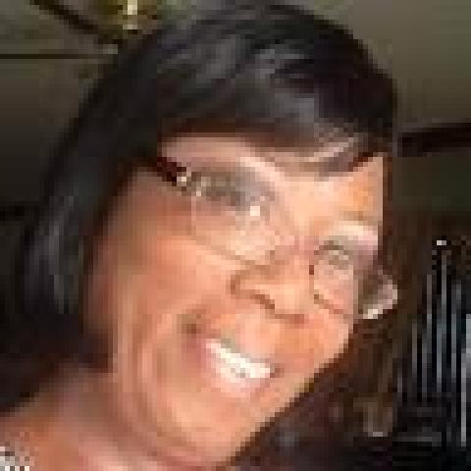
Professor Wanda Curtiss https://www.linkedin.com/in/wanda-curtiss-9909387/
https://www.coursicle.com/mdcwest/professors/Wanda+Curtiss/

Slide 23
Professor Manuel Urena
https://www.coursicle.com/mdcwest/professors/Manuel+Urena/

Slide 24
Professor Sara Scott
https://www.coursicle.com/mdcwest/professors/Sara+Scott/

Slide 25
Professor Laura Olavarrieta
https://www.coursicle.com/mdcwest/professors/Laura+Olavarrieta/

Slide 26
Professor Arian Masvidal
https://www.coursicle.com/mdcwest/professors/Arian+Masvidal/

Slide 27
Professor Heather Delsalle https://www.linkedin.com/in/heather-delsalle-732417a/
https://www.coursicle.com/mdcwest/professors/Heather+Delsalle/

Slide 28
Professor Kendal Moore
https://www.coursicle.com/mdcwest/professors/Kendal+Moore/

