Slide 1
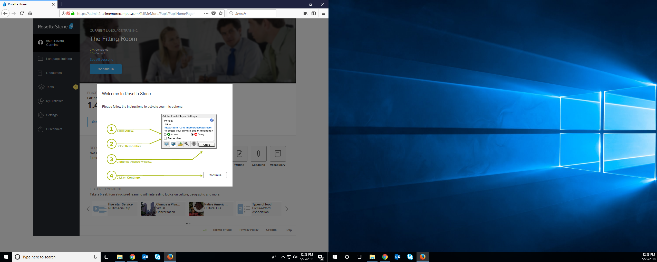
In order to fix the problem with Adobe Flash and Rosetta Stone’s voice recognition using the headset, you have to follow the instructions and use the Mozilla Firefox Server – if you miss this warning, you have to go back to be able to solve this issue.

