Slide 1
Miami Dade College EAP New Students Orientation Go to https://my.mdc.edu
Notes:
This slide refers to the MDC website link. The website for MDC - Miami Dade College is
http://www.mdc.edu

Slide 2
Portals.
STUDENT PORTAL
First thing you need to learn is how to create your email account
The website access uses the username and a PW. That’s why you have to create your email prior to entering in the MDC website.
Notes:
The website access uses the username and a PW. That’s why you have to create your email prior to entering in the MDC website.

Slide 3
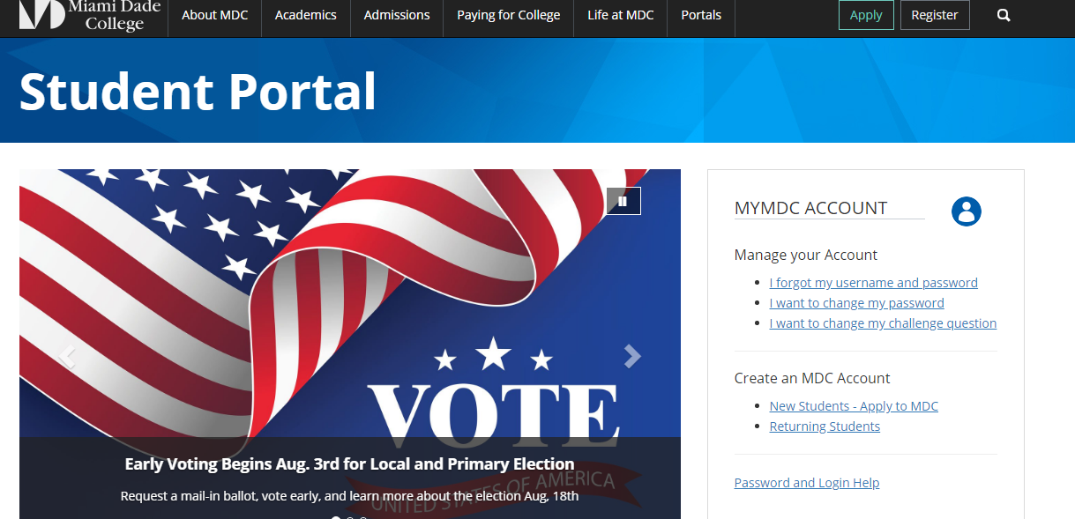

Slide 4
Your ACCOUNT…
If you already have an account and need to retrieve or change your PW you may visit Manage Your Account within the Student Portal.
Any changes to your email username and PW you can do it following prompts or with the help from the librarian.
Notes:
Any changes to your email username and PW you can do it following prompts or with help from the librarian.

Slide 5
How to navigate the MDC website. MD CONNECT to enter into your account to see grades, history, and finances.
The program that MDC uses to keep your records is called MD Connect.

Slide 6
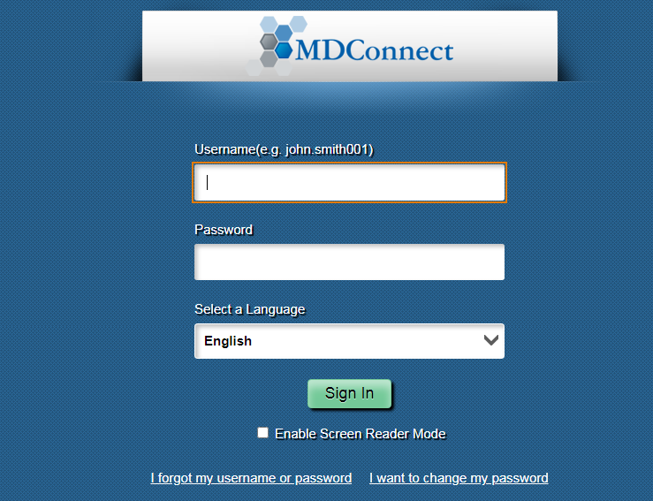

Slide 7
To Register for classes go to MD Connect or your student portal.
You can register your classes through MD Connect or your Student’s Portal.
Notes:
You can register your classes through MD Connect or your Student’s Portal.

Slide 8
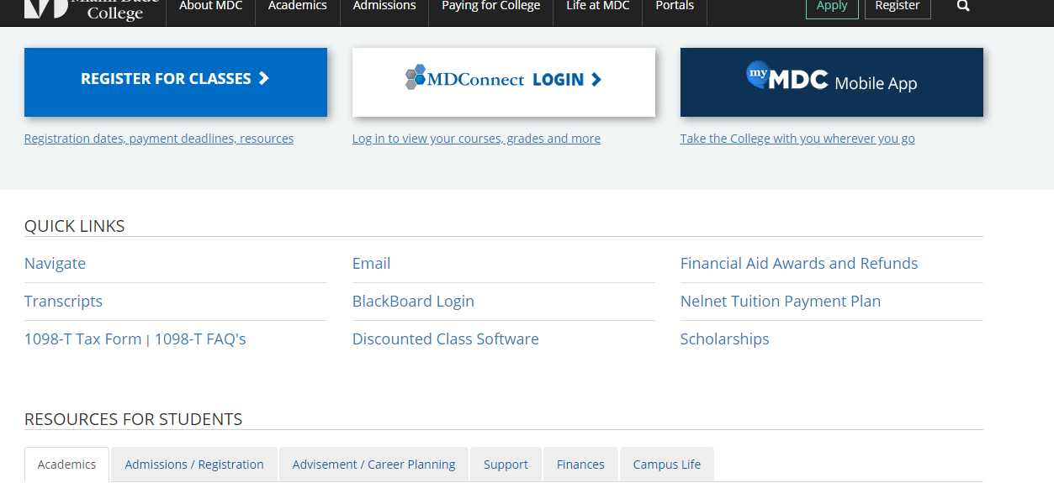

Slide 9
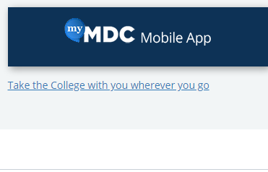
Mobile application.
You can have an MDC Mobile APP installed in your phone for easy access to your academic information.
Notes:
You can have an MDC Mobile APP installed in your phone for easy access to your academic information.

Slide 10
Quick links.
There are quick hyperlinks with information on different subjects.
Notes:
There are quick hyperlinks with information on different subjects.

Slide 11
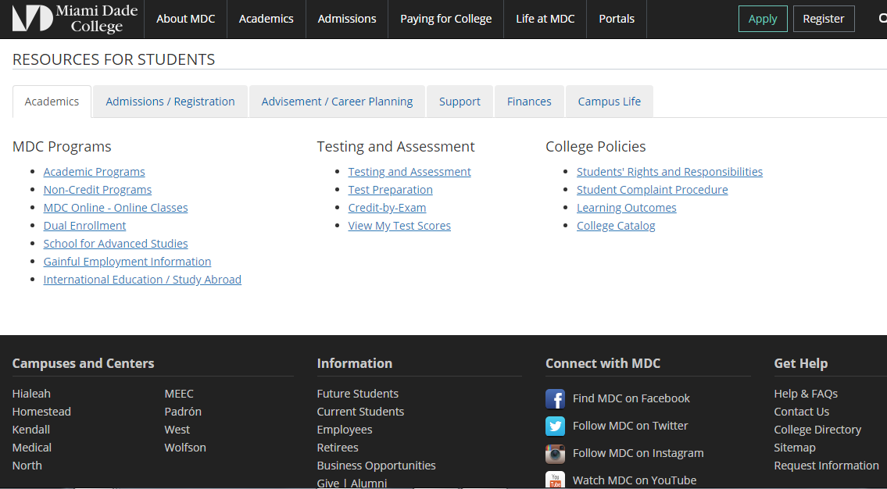

Slide 12
Resources for Students.
There are other resources under different categories for more information or details regarding different departments.
Notes:
There are other resources under different categories for more information or details regarding different departments

Slide 13
EAP Advisement Questions and Answers.
Where do you have to go to enter into the Students Portal?
https://my.mdc.edu/
What do you have to do if you forget your email username/PW?
My MDC Account steps
Where do you have to go to browse your registration?
MD Connect https://mdconnect.mdc.edu
How can you retrieve your MAP? Advisement & Career Planning
https://mdcwap.mdc.edu/IEP/
How can you look into your Degree Audit? Student Self-Service Audit
MD Connect view My Academics -) MyAdvisementReport
View Report as PDF
Notes:
Questions and Answers regarding this presentation.

