Slide 1
Business programs
https://www.mdc.edu/academics/programs/meta-business.aspx

Slide 2
UNLEASH YOUR POTENTIAL

Slide 3
FIND YOUR PROGRAM

Slide 4
NAVIGATE

Slide 5
ADMISSIONS

Slide 6
Credit Application link https://mdcwap.mdc.edu/admission/

Slide 7
ACADEMIC PROGRAMS-BAS https://www.mdc.edu/supervisionmanagement/

Slide 8
PROGRAM DESCRIPTION & COURSE LIST https://www.mdc.edu/academics/programs/ps/P9200.pdf

Slide 9
ASSOCIATE IN ARTS & SCIENCE

Slide 10
AA BUSINESS ADMINISTRATION https://www.mdc.edu/academics/programs/csg/aa_businessadministration_csg.pdf

Slide 11
AS BUSINESS ADMINISTRATION https://www.mdc.edu/academics/programs/ps/25051.pdf

Slide 12
COLLEGE CREDIT CERTIFICATES CCC

Slide 13
ADVANCE TECHNICAL CERTIFICATE ATC

Slide 14
CERTIFICATE https://www.mdc.edu/managementspecialist/

Slide 15
ADVANCED TECHNICAL CERTIFICATE https://www.mdc.edu/humanresourcemanagementcertificate/

Slide 16
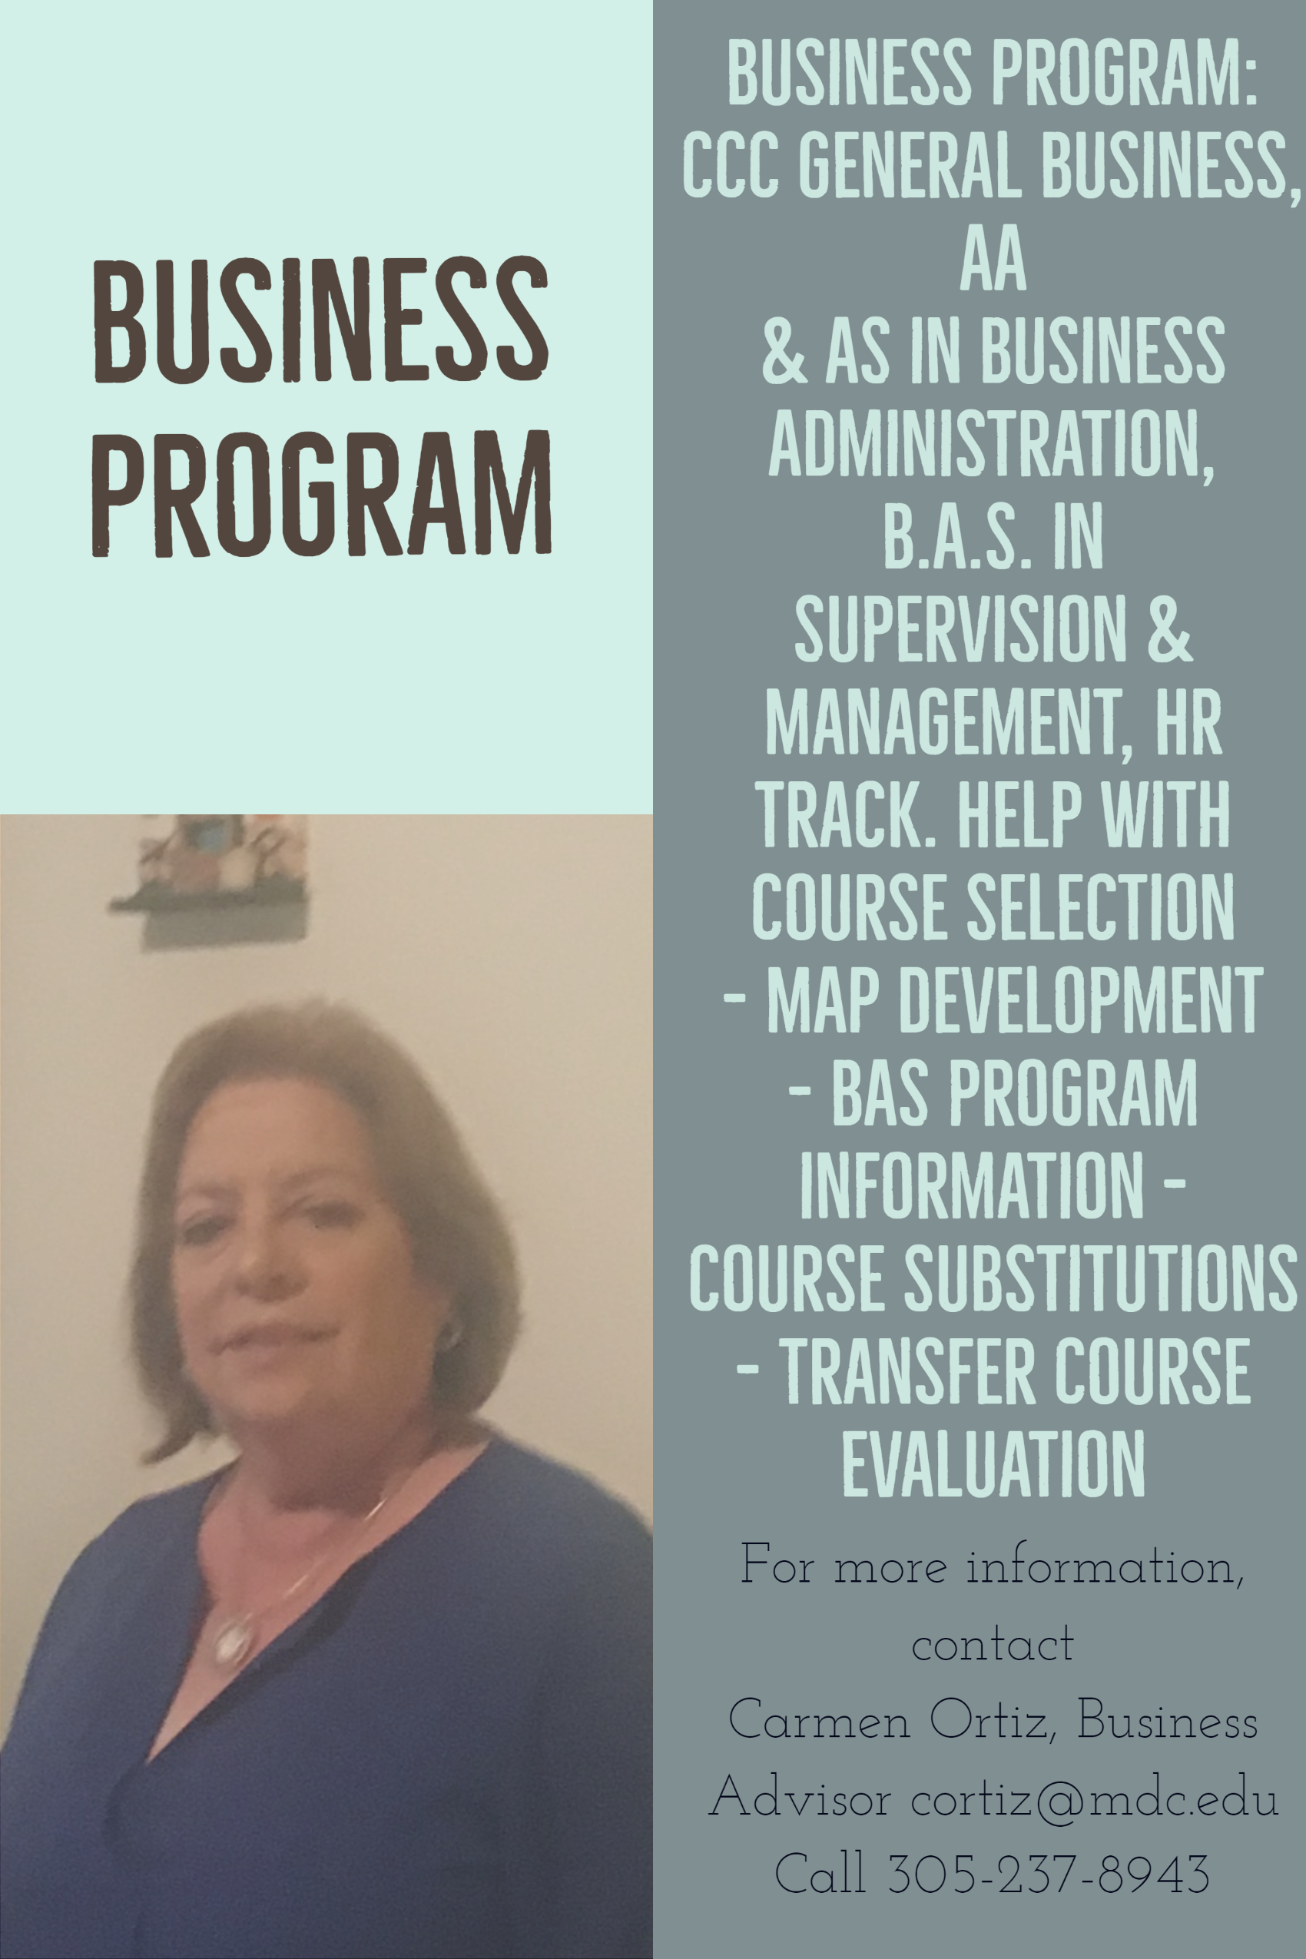
Q & A
https://faq.mdc.edu/kb/advisement/
Where do students have to apply for the BAS in Business Program?
https://www.mdc.edu/academics/programs/bachelors.aspx
Who can assist students in selecting their Business courses?
Your Business Advisor.
Carmen Ortiz, Business Advisor - West
Office of Academic Affairs
Address: 3800 N.W 115th Avenue, Room # 1218
Miami, Florida 33178
Office: (305) 237 – 8943 Email: cortiz@mdc.edu
Work hours: M 2:00PM - 7:00PM T - F 11:00AM - 4:00PM

