Slide 1
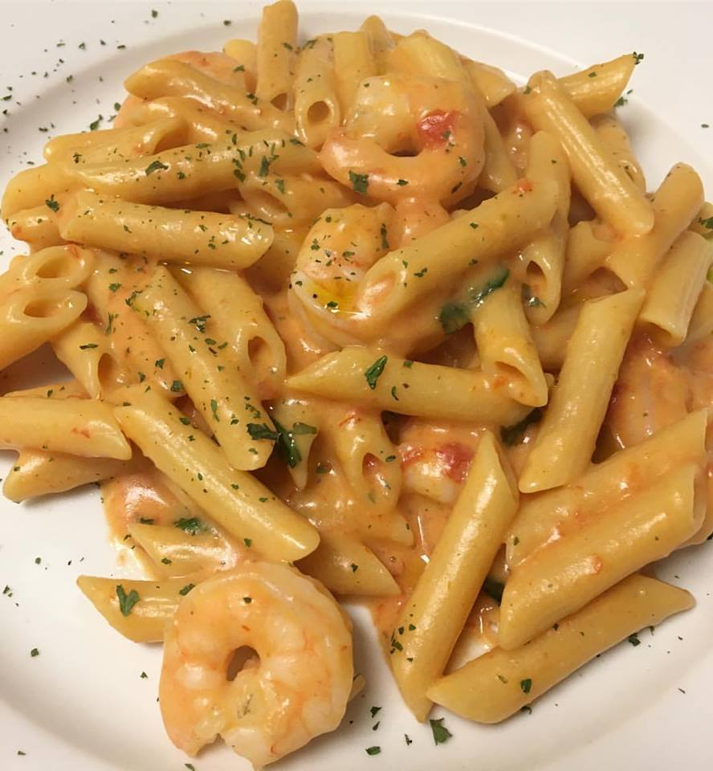
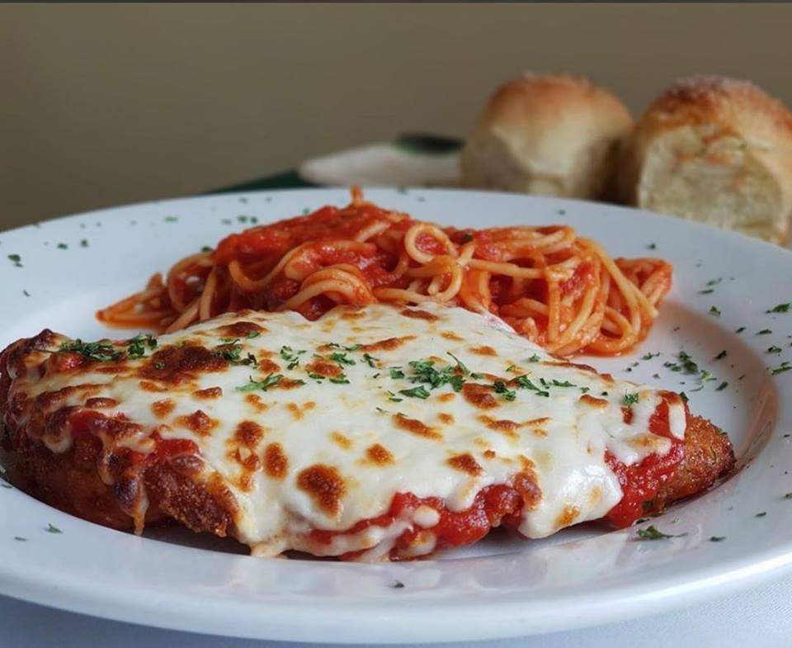
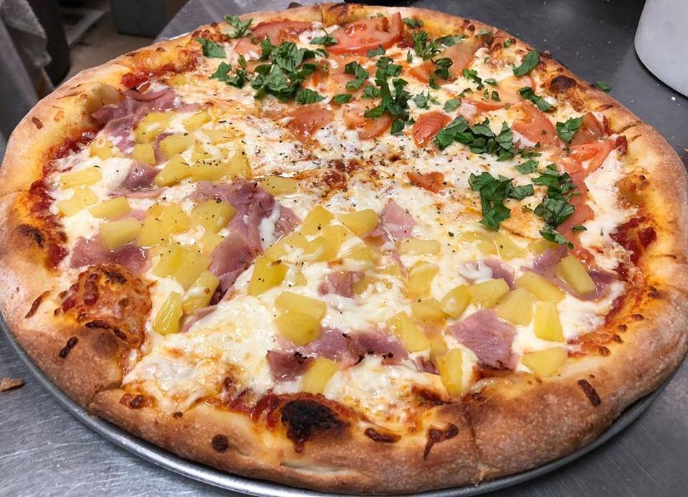
Academic Support Lab Holiday Celebration www.capellidangelo.us
Please join us to celebrate our end-of-term celebration at Capelli D’Angelo Restaurant located at 4001 SW 152 Ave Miami FL 33185
Date: December 8th Time: 1:30 p.m. Please RSVP to Veronica
@capellidangelo.us

