Slide 1
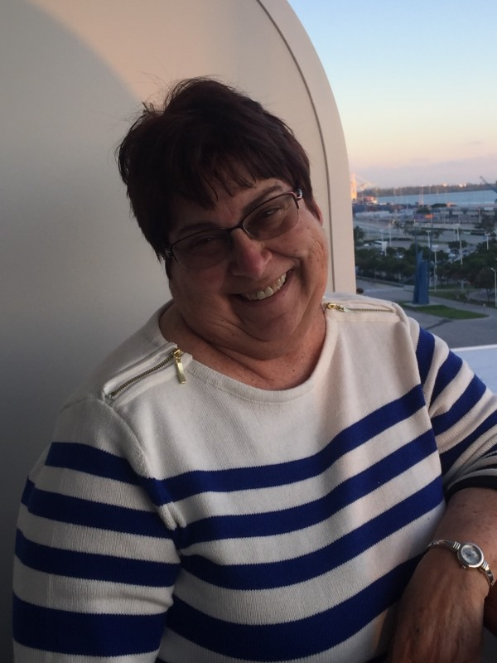
Meet your EAP Advisor
Dear Students:
Here, in Academic Affairs – Liberal Arts Department, we are dedicated to furthering your educational goals. Academic success is dependent on your effort! Allow us to guide you by providing resources to enhance your education at Miami Dade College, West Campus.
Meet Bertha Cabrera!
Advisory Role
Course Selection
Course Placement
My Academic Plan (MAP) Development
English for Academic Purpose (EAP) Program Information
EAP Orientation Workshop
Career Development
EAP Ambassador Volunteer Program
Contact information:
Office: Virtual Platform
EAP Advising, 305-237-8468
EAP Advising email: westeapadvisor@mdc.edu
Direct Email: bcabrera@mdc.edu
Program Information:
English for Academic Purpose is a program to foster learning of the English Language in pursuit of an academic degree and entry into the workforce.
Need help registering for Summer and Fall 2020 courses? Contact us at 305-237-8938

Slide 2
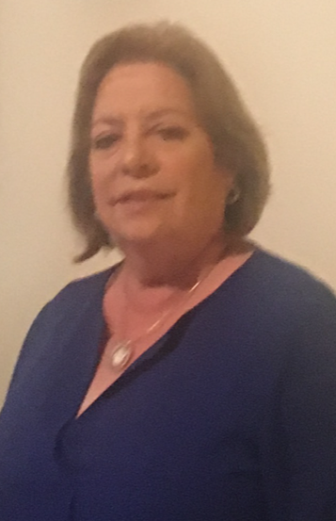
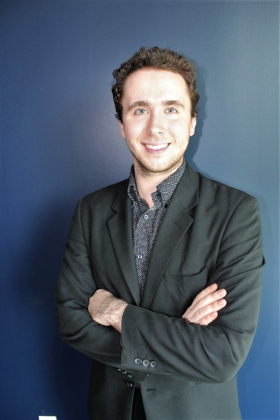
Liberal Arts Department
Majors:
Anthropology
Architecture
Art or Art Education
Computer Arts Animation
Criminal Justice Administration
Dance
Drama or Drama Education
Graphic or Commercial Arts
History
Mass Communication
Music Education
Philosophy
Political Science
Psychology
Public Administration
Recreation
Religion
Social Work
Sociology
Teaching
Dear Students:
Here, in Academic Affairs – Liberal Arts Department, we are dedicated to furthering your educational goals. Academic success is dependent on your effort! Allow us to guide you by providing resources to enhance your education at Miami Dade College, West Campus. (Personalized statement from Assistant to the Chairperson or Dean of Faculty)
Meet our Advising Team!
Contact information:
Office: Virtual Platform
Liberal Advising, 305-237-8938
Carmen Ortiz
Andres Arnavat
Bertha Cabrera
Need help registering for Summer and Fall 2020 courses? Contact us at 305-237-8938

